Slide 1
Analyzing the Dynamic Response of Linear Constant Discrete-Time Systems
Basic signals
  Unit pulse
  Unit step
  Exponential
  Sinusoid
Correspondence of z-plane pole locations with s-plane pole locations
Step response

Slide 2
Analyzing the Dynamic Response of Linear Constant Discrete-Time Systems
Given a difference equation relating an input signal e_{k} and an output signal u_{k} , and given e_{k} , find u_{k} .
We can solve for u_{k} by either
  Solving difference equation directly
  Going to z-domain and back:
    Find H(z) (transfer function)
    Compute E(z)
    Compute U(z) = H(z) E(z)
    Find inverse z-transform of U(z): u_{k}

Slide 3
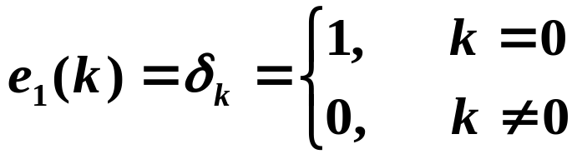
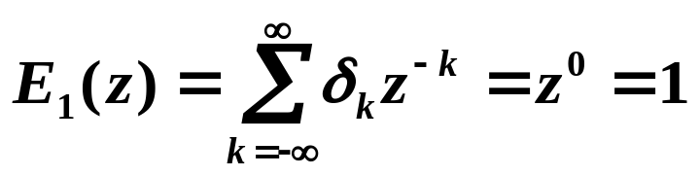
Basic Signals
δ_{k}
Unit Pulse
1
k
No finite poles or zeros
Similar to continuous-time unit impulse function (whose Laplace transform is 1).
One way to experimentally determine H(z) is to input δ_{k} into the system, then the Z-transform of the output is U(z) = H(z) E(z) = H(z).

Slide 4
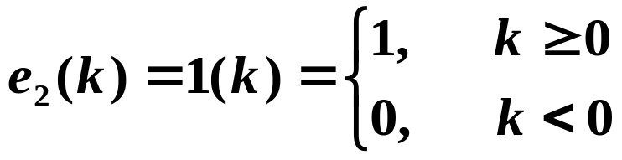
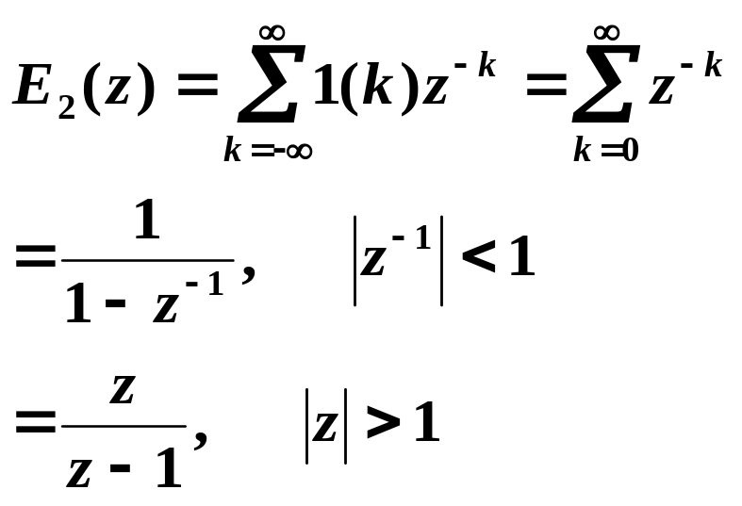
Unit Step
1(k)
1
k
Im(z)
1
Re(z)
-1
1
-1
Zero: 0
Pole: 1

Slide 5
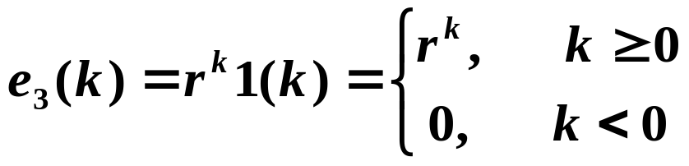
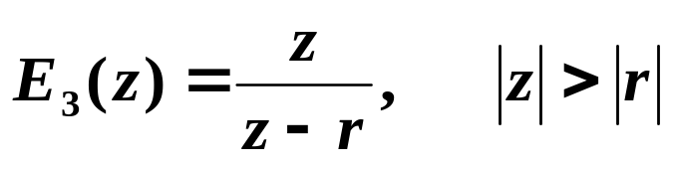
Exponential
Im(z)
1
Re(z)
-1
r
1
-1
Zero: 0
Pole: r
|r|< 1 ➔ stable, decaying signal, pole inside unit circle
|r|= 1 ➔ unit step, marginally stable, pole on unit circle
|r|> 1 ➔ unstable signal, pole outside unit circle

Slide 6
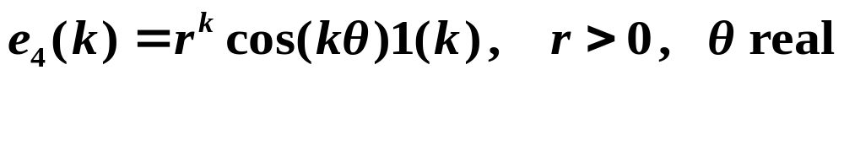
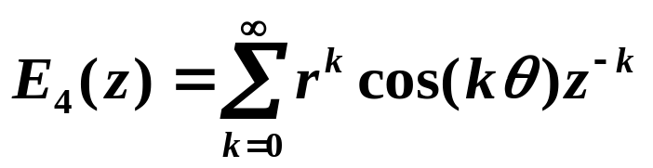
Sinusoid
e₄(k)
1
k

Slide 7
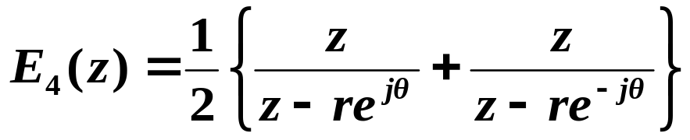
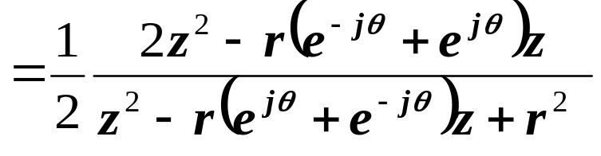
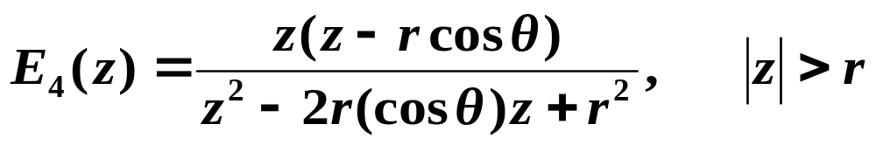

Slide 8
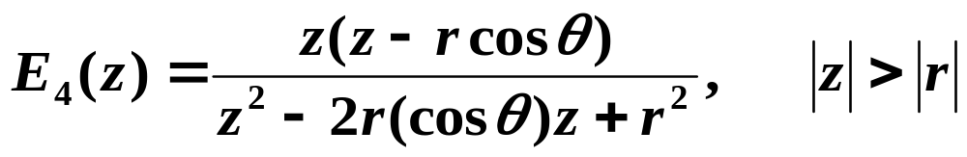
Zeros:
Poles:
Im(z)
1
Re(z)
-1
1
-1

Slide 9

r < 1 ➔ decaying sinusoid, stable, poles inside unit circle
  The closer the poles are to the origin, the faster the decay.
r = 1 ➔ constant amplitude sinusoid, marginally stable, poles on unit circle
r > 1 ➔ growing sinusoid, unstable, poles outside unit circle
Note that the number of samples per period (or oscillation) is determined by θ .
See Figure 4.24 of text (also last page of Lab 1 handout).

Slide 10
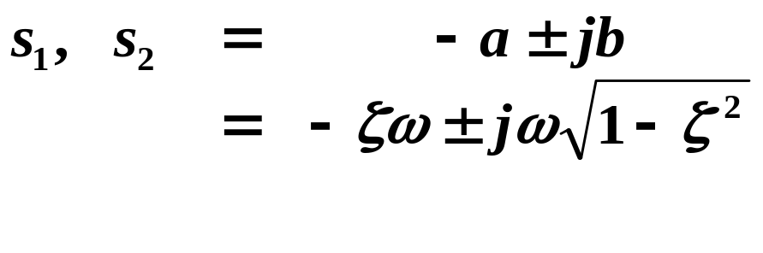
Correspondence of z-Plane Pole Locations with s-Plane Pole Locations
Recall for 2nd-order Laplace transform:
  Stable if poles in LHP
Sampled signal:
Im(s)
poles:
Re(s)

Slide 11
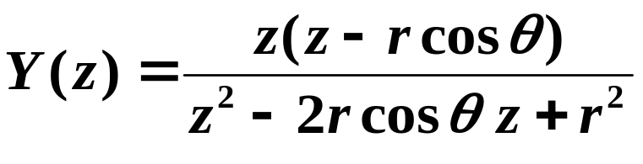
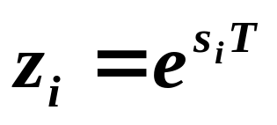
Poles:
In general, if a continuous signal y(t) has Laplace transform Y(s) with poles s₁ , s₂ , . . . , then the sampled (discrete) signal y(kT) has z-transform Y(z) with poles z₁ , z₂ , . . . where

Slide 12

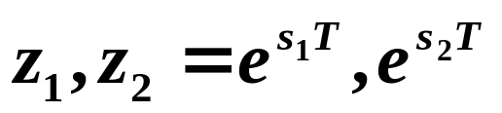
Example Correspondences
s-plane
z-plane
Im(s)
Im(z)
1
Re(s)
Re(z)
-1
1
-1
Stability boundary

Slide 13
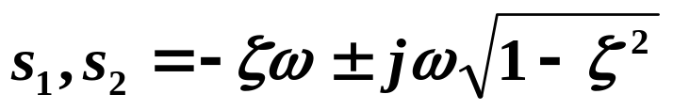
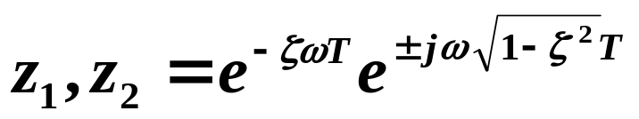
s-plane
z-plane
Im(s)
Im(z)
1
Re(s)
Re(z)
-1
1
-1
Constant damping
See Figure 4.24 of text.

Slide 14
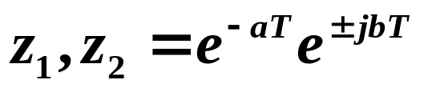
s-plane
z-plane
Im(s)
Im(z)
1
Re(s)
Re(z)
-1
1
-1
Constant b

Slide 15
Mapping from s-plane to z-plane is many-to-one:

Slide 16
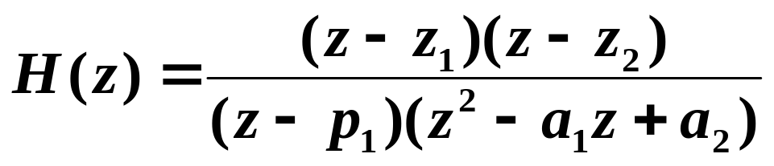
Step Response
What are step-response characteristics given the poles and zeros of the system?
Consider
First, let z₁ = p₁ so that the system is of 2nd order.
Z-transform of unit pulse response is z⁻¹ E₄(z) .

Slide 17
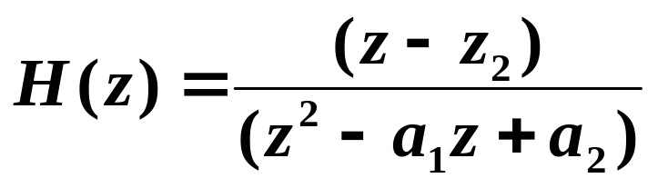
Effect of zero location on step response
Major effect of zero z₂ is on overshoot. See Figures 4.29 - 4.31 of text.
Im(z)
1
Re(z)
-1
1
-1

Slide 18
Effect of 3rd pole p₁
Let z₁ = z₂ = -1 (so zeros have little influence on step response)
Main effect of p₁ is on rise time. See Figure 4.32 of text.
Im(z)
1
Re(z)
-1
1
-1
In general, extra zeros and (stable) poles have small effect if on the negative real axis.
As extra zeros approach +1, overshoot increases.
As extra poles approach +1, rise time increases.

